Slide 1
Democratization in South Korea
Zixuan Li
Shenzhen Middle School, Shenzhen, China
Saturday, March 15, 2025

Slide 2
OutliNE
1. Overview
2. Four phases of democratization
  2.1 Aborted democratization and shrunken social movements
  2.2 Liberalization
  2.3 Transition
  2.4 Post-transition period
3. Summary

Slide 3
1. Overview
1972-1982: fluctuating
1982-1993: rapid decrease
After 1993: stable
1982 -----------> 1993
Source: https://freedomhouse.org
Notes:
This is the graph of the freedom score of Korea. We can see that from 1972 to 1982, Korea’s Freedom scores experienced constant fluctuations, but never fell under 4.5. Except in 1972, Korea remained in the “partly free” category in this decade.
However, in the period from 1982 to 1993, there was a drastic decrease in all of the scores, and Korea became a “free” country in 1988.
In the following years, Korea maintained a stable democracy.
In years 2004-2012, there was a minor decrease in the Political Rights score, but later returned to 2.

Slide 4
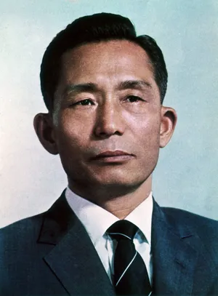
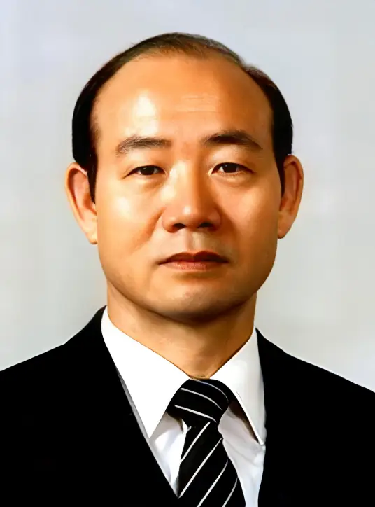
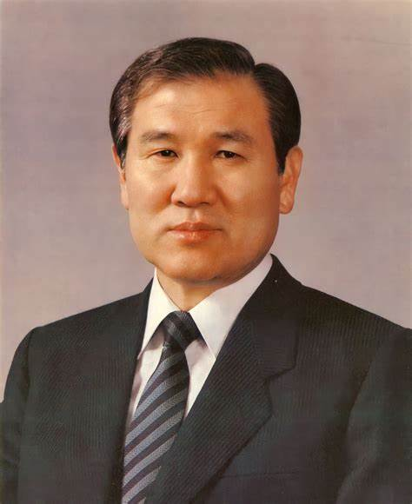
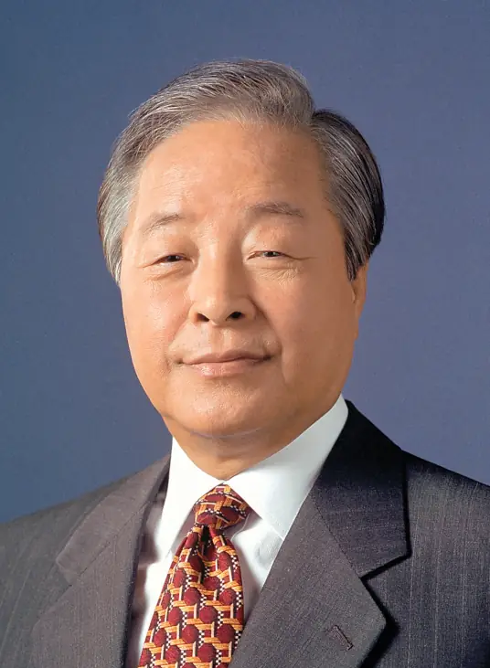
1. Overview
3rd president
5th president
6th president
7th president
Park Chung-Hee (1961-79)
Military dictator
Chun Doo-Hwan
(1980-88)
Military dictator
Roh Tae-Woo
(1988-93)
Elected president
Kim Young-Sam
(1993-98)
Civilian president
Notes:
First, I will briefly introduce the political leaders during that period. The third president of Korea, Park Chung-Hee, was a military dictator who controlled the media and suppressed civil liberties. He was assassinated in 1979.
His successor, Chun Doo-Hwan, was also a military dictator who seized power through a coup. He continued the authoritarian regime and ruled from 1980-1988.
The sixth president, Roh Tae-Woo, was the first democratically elected president who served from 1988 to 1993.
Then, in 1993, Kim Young-Sam became the first civilian president who was not from the military, marking Korean democracy entering a stable period.

Slide 5
2. Four phases of democratization
2.1 Aborted democratization and shrunken social movements (October 1979-December 1983)
2.2 Liberalization (January 1984-April 1987)
2.3 Transition (April 1987-June 1987)
2.4 Post Transition Period (After June 1987)
Source: Yun, Seongyi. ‘Democratization in South Korea: Social Movements and Their Political Opportunity Structures’. Asian Perspective 21, no. 3 (1997): 145–71.
Notes:
Generally, there are four phases in the process of democratization in Korea. The first phase, from October 1979 to December 1983, was the Aborted democratization and shrunken social movements. The second phase was Liberalization, the third phase Transition, and lastly the Post-transition period. Among these phases, the first and third phases were the most important because two vital events, the Kwangju Uprising and the June Uprising, happened during these periods.

Slide 6
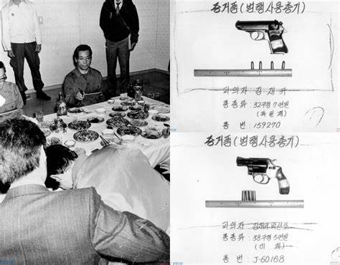
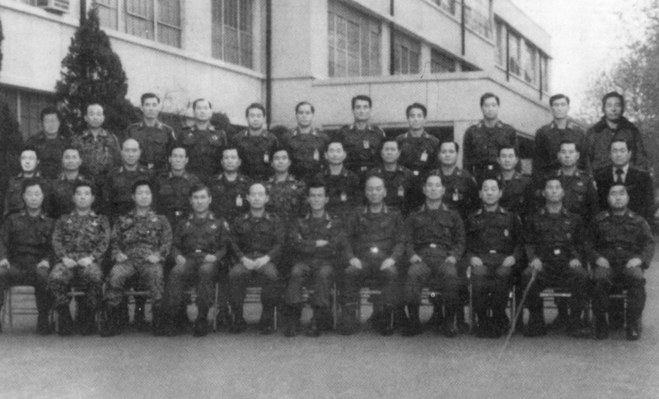
2.1 Aborted democratization and shrunken social movements (1979-1983)
Key words: unsuccessful attempts, laying groundwork
In 1979, Korea seemed to have an opportunity for democratization.
The ruling Democratic Republican Party (DRP), was in a difficult position.
The opposition party was also weak and largely unprepared.
The only group that could fill the vacancy was the military.
On December 12, 1979, Chun Doo-Hwan gained supremacy in the military through an internal coup and continued the authoritarian rule.
Notes:
In the first period, Korea’s civil society was largely underdeveloped and the opposition forces were weak after being repressed for a long time. Besides, the middle class in Korea was not very active, and the US prioritized maintaining stability rather than supporting the democratic movements. Therefore, although there were calls and attempts for reform, most of them were unsuccessful. However, they laid the groundwork for future movements.
In 1979, after the assassination of Park Chung-Hee, there was a power vacuum and Korea seemed to have a vital opportunity for democratization.
At the same time, the opposition party was also weak and largely unprepared.
As a result, the only group that could fill the vacancy was the military.
On December 12, 1979, Chun Doo-Hwan gained supremacy in the military through an internal coup. He continued the authoritarian rule by declaring martial law and kept violently repressing his dissenters and democratic movements. His actions led to the Kwangju Uprising.

Slide 7
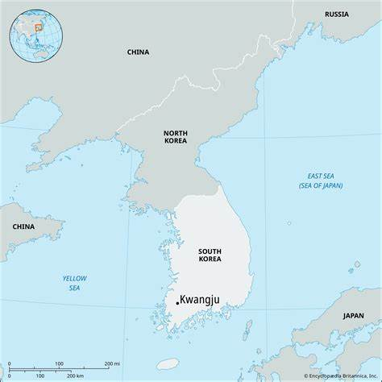
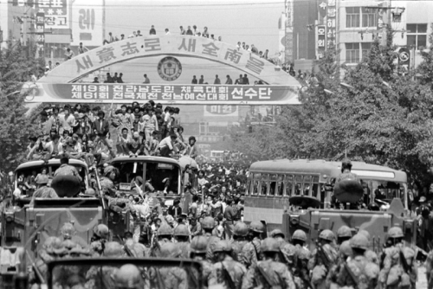
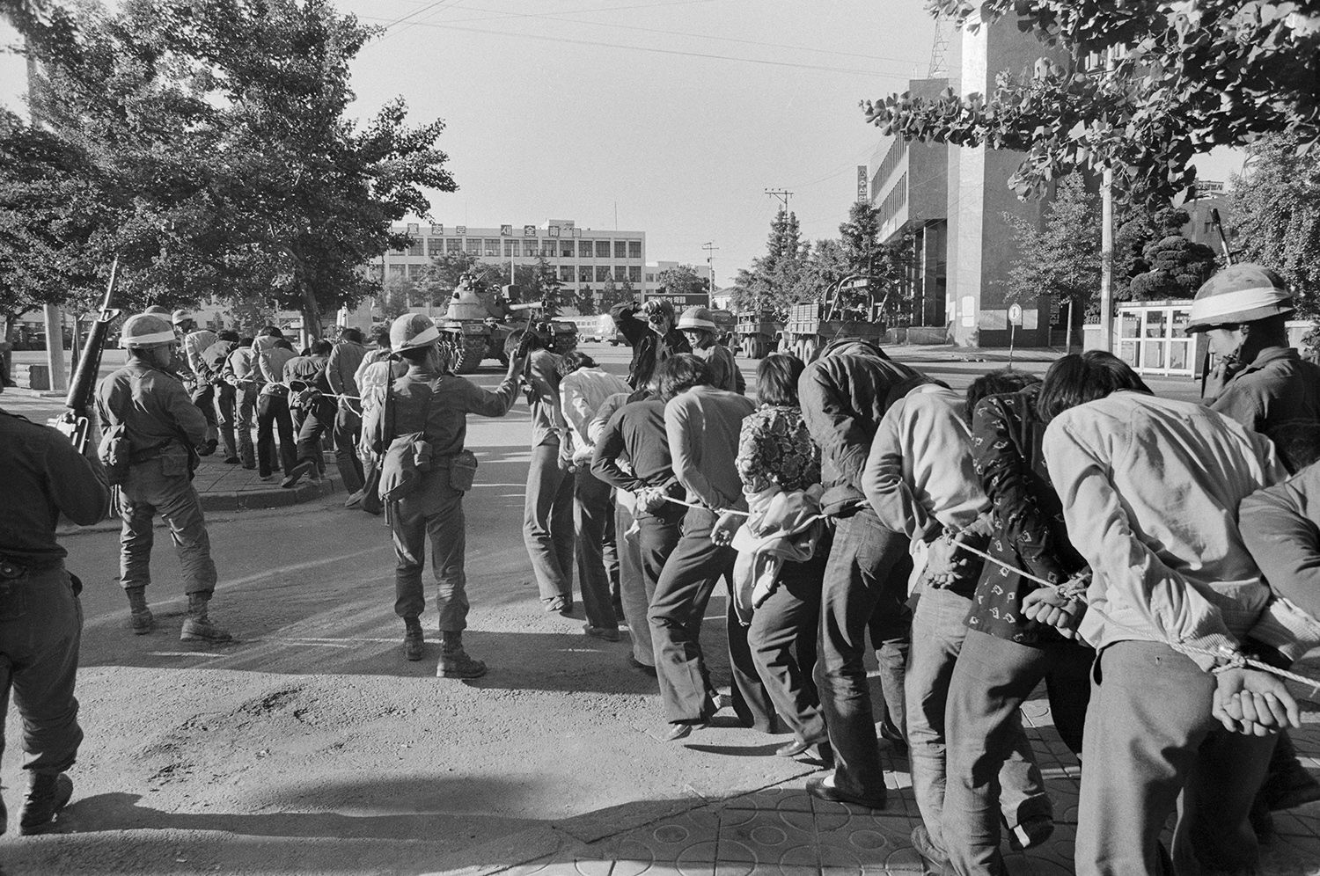
2.1.1 Key Event: Kwangju Uprising
On May 18, 1980, a popular uprising broke out in Kwangju against Chun’s actions.
The citizens, including many students, formed a militia and shortly controlled the city.
As a response, Chun deployed national guards and special paratroopers to suppress the protesters.
Sources: 1. https://chathamhouse.org; 2. Kim, Elli. ‘Research Guides: South Korean Democratization Movement (1960s-1980s)
Notes:
On May 18, 1980, a popular uprising broke out in Kwangju. Citizens protested against Chun Doo-Hwan’s actions and demanded democratic reforms and the end of martial law.
The citizens, including 5,000 students, formed a militia and shortly controlled the city.
As a response, Chun deployed national guards and special paratroopers to suppress the protesters. The soldiers fired at civilians indiscriminately, and the precise number of casualties is still unknown.

Slide 8
2.1.2 Kwangju Uprising: significance
The tragic event did not gain a lot of support at the time.
In the following years, it continued to divide progressives and conservatives.
Undeniably, the Kwangju uprising would act as a rallying point for continuing student-led protests and a sustained campaign for democracy that continued throughout the 1980s.
Notes:
Despite being a tragic event, the Kwangju uprising did not receive support from people outside the city and the US. In the following years, it will continue to divide progressives and conservatives.
For progressives, the event was a milestone in the democratization of Korea and served as a catalyst for positive political change.
For conservatives, however, it was viewed as an insurrection led by communist forces, with possible encouragement from North Korea. This narrative was also adopted by the Chun administration at the time.
However, the Gwangju uprising would undeniably act as a rallying point for continuing student-led protests and a sustained campaign for democracy that continued throughout the 1980s.

Slide 9
2.2 Liberalization (1984-April 1987)
Key words: expanded opposition
Government repression was relaxed
A strong opposition party, the New Korean Democratic Party (NKDP), emerged.
Chun released politicians and student activists to restore legitimacy.
As a result, opposition forces regained momentum and revitalized.
In 1985, the NKDP won 67 of 276 seats in the National Assembly and gained 30% of the popular votes.
In the same year, the United Minjung Movement for Democracy and Unification was founded.
Notes:
In the second phase, government repression for social movements was relaxed and a strong opposition party, the New Korean Democratic Party, emerged.
In order to restore the lost legitimacy in the Kwangju uprising and relieve social tensions, Chun released opposition politicians and student activists, and withdrew police from campuses.
He believed that he could control the opposition groups. However, the opposition forces quickly regained momentum and revitalized.
In the general election of 1985, the NKDP won 67 of 276 seats in the National Assembly and gained 30% of the popular votes.
In the same year, the United Minjung Movement for Democracy and Unification was founded. It was the first umbrella organization that contained broad sectors of opposition forces including workers, students, farmers, religious communities and journalists.

Slide 10
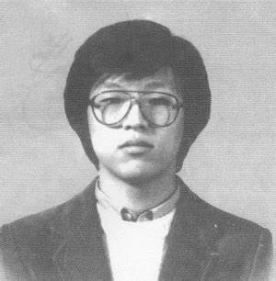
2.3 Transition (April 1987-June 1987)
Key words: cooperation, outburst
The participation of the middle class and the support of the US
Causes: 1. The April 13 measure
2. The death of a college student
Results: 1. US change of policy
2. The June Uprising
Notes:
In the third period, the most significant changes appeared in the attitudes of the middle class and the US government. Before 1987, the middle class was not eager to take the risks of confronting a militant authoritarian regime. However, they were ignited by the April 13 measure in 1987, which changed direct presidential election to indirect election. Another incident that turned them into active supporters for the social movements was the torture and death of a college student named Park Jong-Cheol. The participation of hundreds of thousands of the previous silent middle class in the democratic movements also urged the US government to change their attitude. They sent a strong message to the Korean government that they opposed any form of military intervention. Then, the June uprising broke out, which turned Korea into a democratic country.

Slide 11
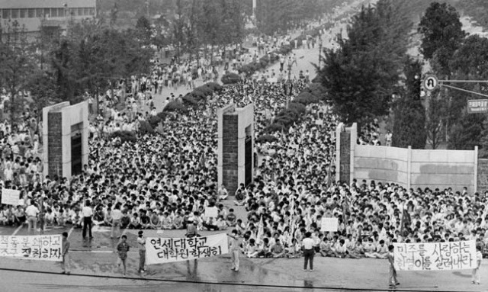
2.3.1 Key event: The June Uprising
On June 10, 1987, protests broke out across the country.
People rushed to the streets to mourn for Park Jong-Cheol and Lee Han Yeoul.
The call for democratic reforms was stronger than ever.
On June 29, Roh Tae-Woo promised direct presidential elections and further democratic reforms.
Notes:
On June 10, 1987, protests broke out across the country.
People rushed into the streets to mourn for Park Jong-Cheol and Lee Han Yeoul. The former was the student who died in interrogation, and the latter was also a student who was severely injured by a tear gas grenade the previous day.
There were over a hundred protests in one day, and the call for democratic reforms was stronger than ever.
Finally, on June 29, the government surrendered as Roh Tae-Woo, the presidential candidate of the ruling Democratic Justice Party, promised direct presidential elections and further democratic reforms.

Slide 12
2.4 Post-transition period (after June 1987)
Key words: reform, democratization
The two opposition leaders took part in the election in December 1987.
Roh Tae-Woo won the election in December 1987.
He kept his promise and conducted democratic reforms.
In the general election of 1988, the Democratic Justice Party lost the majority.
Established diplomatic relationships with many countries, including Russia and China.
In 1991, Korea joined the United Nations.
In 1993, he was succeeded by Kim Young-Sam.
Notes:
In the final period of Korean democratization, we see the first free election. The two previously banned opposition leaders, Kim Young-Sam and Kim Dae-Jung, ran for the presidency. However, because they split the opposition votes, Roh won the election. In his terms, he kept his promise. He reduced military influence and increased political competition. As a result, in the general election of 1988, the Democratic Justice Party lost the majority in the National Assembly, although it later formed a new Democratic Liberal Party with several minor parties. He also established diplomatic relationships with many countries, including Russia and China. In 1991, Korea joined the United Nations. Then, when he was succeeded by Kim Young-Sam in 1993, Korea’s democracy entered a stable period.

Slide 13
3. Summary
In summary, Korea’s democratization was a gradual process.
Gradual Democratization: Korea’s transition to democracy happened over time.
Kwangju Uprising (1980): Served as the catalyst for democratic movements.
Growing Public Support: More people joined pro-democracy movements throughout the 1980s.
June Uprising(1987): Unified society, overthrew military rule, and led to democratization.
Notes:
In summary, Korea’s democratization was a gradual process. The Kwangju Uprising in 1980 was the start of the whole process and served as a catalyst. In the following years, more and more people joined the democratic movements until in 1987, the June Uprising unified nearly all sectors of Korean society, overthrew the military government, and turned Korea into a democratic country.

Slide 14
Thank You!

